Slide 1
Chapter 7
Benefits and Cost Analysis:
Benefits

Slide 2
Learning Objectives
Distinguish between direct and indirect methods of calculating the Willingness To Pay (WTP) for improvements in environmental quality.
Explain the concept of producer surplus and how to calculate it graphically.
Explain the concept of consumer surplus and how to calculate it graphically for a market good and a public good.
Describe four methods of imputing WTP for improvements in environmental quality.
Explain why Willingness To Accept (WTA) estimates generally exceed those of WTP.

Slide 3
Benefits
In a BCA for an environmental program or project, the benefits are generally an improvement in environmental quality
To measure a complete emissions damage, it is necessary to go through the following steps:
1. Measure emissions
2. Determine the resulting ambient quality
3. Estimate human exposure
4. Measure impacts (health, aesthetic, recreation, ecosystem, etc.)
5. Estimate the values of these impacts

Slide 4
Video material
https://www.youtube.com/watch?v=5BmqjvTv1yQ

Slide 5
Impacts of emissions
Health damages
Output loss and Material Damages

Slide 6
Impacts of damages
Health damages
Reduction in productivity (loss of human capital)
Costs related to health care (Increased medical expenditure)
Mortality and morbidity (e.g., days absent from work)
Output loss and Material damages
Agricultural production losses (farms: crop losses, animal diseases, etc.)
Production losses in Natural resources sector (forestry, fishery, etc.)

Slide 7
Benefits (cont.)
People are Willing To Pay (WTP) for projects and programs that will help to avoid a decline in environmental quality or improve the quality of the environment
For example, people are WTP the cost for exhaust systems on cars, trucks and buses because they receive the benefits of cleaner air
People may also be WTP to clean up a polluted site
LO1

Slide 8
Calculating Willingness to Pay (WTP)
Determining a population’s WTP to reduce pollution is often complex because there is no market where people buy and sell units of environmental quality.
Two main ways to measure WTP exist:
Direct: WTP reflects how much people would be WTP to avoid the harm caused by pollution. Examples the health costs caused by pollution, the loss of productivity caused by pollution, or the amount paid to remediate a polluted site.
LO1

Slide 9
Calculating Willingness to Pay (cont.)
In-direct: An Individual’s behavior or choices are used to input WTP. This is done when no actual market exists to reflect environmental values.
Several methods might be used including:
Preventive/Mitigating Expenditures
Hedonic Estimates
Surrogate Markets
Contingent Valuation
LO1

Slide 10
Valuing Environmental Quality
Direct approaches (market prices used)
Method | Environmental Application
1. Changes in productivity | Health effects of pollution Pollution impacts on agriculture, natural resources
2. Health-care costs | Health effects of pollution
3. Loss of human capital | Health effects of pollution
4. Replacement/restoration of damaged property, businesses | Pollution damage to structures Ecosystem damage (e.g., oil spill)
LO1

Slide 11
Producer and Consumer Surplus
Producer and consumer surplus show the net benefits of production or consumption and allow maximum WTP for change in pollution to be found.
An individual's WTP for a change in pollution will likely be equal to their total benefit gained from reduced environmental damage.
LO2/3

Slide 12
Benefits from Reduced Production Costs
Benefits from reduced production costs as a result of reduced pollution levels are shown by a shift in the supply curve from S1 to S2.
The improvement in net income or producer surplus is the difference between q1 and q2 or (b+d). This amount would be the maximum someone would be willing to pay to reduce pollution.
LO3

Slide 13
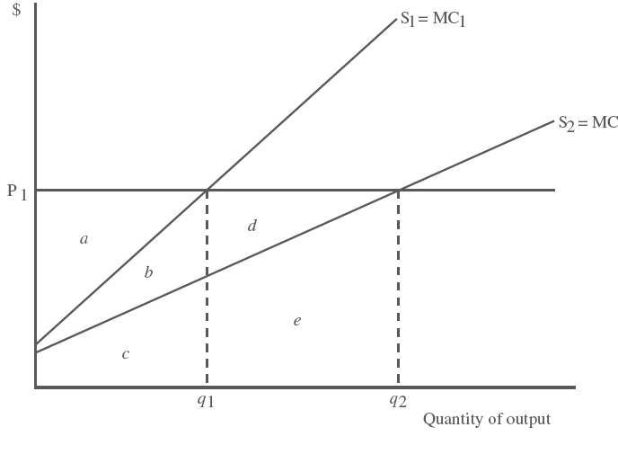
Benefits from Reduced Production Costs
Producer Surplus:
For S1: a
For S2: a + b + d
Production increases
from q1 to q2 because of lower costs.
LO3

Slide 14
Example
S1 = 5 + 0.8q₁ and S2 = 4 + 0.5q₂. [Look at the slopes]
Price = $10; We set P=S1 and P=S2
[See the graphs on the board]
Vertical Intercept = 5 when q₁=0;
Vertical intercept = 4 when q₂=0
1) Find q₁ = (P – 5)/0.8 = (10 – 5)/0.8 = 6.25
q₂ = (P – 4)/0.5 = (10 – 5)/0.5 = 12
2) Find Producer Surplus for q₁: [(10-5)x6.25]/2 = 15.625
Find Producer Surplus for q₂: [(10-4)x12]/2 = 36
3) Find net benefits: Change in Producer Surplus =
= 36 - 15.625 = 20.38

Slide 15
Let’s practice!
Exercise 7-16

Slide 16
Real-life estimates of damages
Several Canadian studies have been done on the effects of ground-level ozone on crops.
Ozone is seen as the most damaging air pollutant to crops in Canada, impairing the growth and yields of sensitive plants.
The value of reduced crop yields per year in southern Ontario ranges from $17-million to $70-million, depending on the year chosen. The reason the range is so large is that the number of severe ozone days varies per year.
Lost production in the Fraser Valley of B.C. is estimated at $8.8-million annually.

Slide 17
Consumer Surplus
Consumer surplus is the difference between the consumer’s WTP for a good as represented by his demand curve and the market price of the good summed over all units of the good purchased.

Slide 18
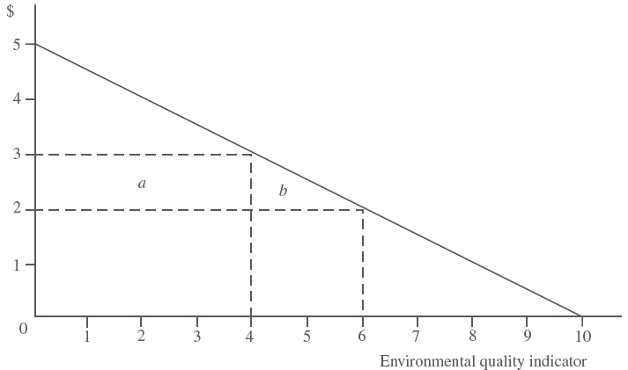
Deriving Consumer Surplus for a Public Good
Figure shows that people are willing to pay $3 for the fourth unit of environmental quality but only $2 for the sixth. The change in consumer surplus from 4 to 6 units is the area under the demand curve (a + b). It is equal to $5.
This allows WTP to be inferred since there is no market available for people to trade units of environmental quality.
P = 5 – 0.5Qd
LO3

Slide 19
Example
If the inverse demand equation for a market good is equal to: P^{D} = 105 - 0.5Q^{D}. What is the consumer surplus associated with consumption of 20 units of the good?
When 20 units are consumed, the price will be $95. Consumer surplus will be equal to the area of a triangle with height 10 and width 20 which is $100.

Slide 20
Let’s practice!
Exercise 7-18

Slide 21
Problems with Direct Damage Measures
Direct damages estimates are almost always seriously incomplete and underestimate total damages.

Slide 22
Methods of Imputing WTP
There are 4 ways of finding out how much people are WTP for improvements in environmental quality:
Preventative or mitigation expenditures
Hedonic estimation
Surrogate markets
Contingent valuation
LO4

Slide 23
Methods of Imputing WTP
Preventative or mitigation expenditures
This method measures how much money people are willing to spend to prevent or avoid poor environmental conditions. For example looking at data on how much money people spend on air purification systems in a city can be a measure of their WTP for better air quality.
LO4

Slide 24
Methods of Imputing WTP (cont.)
Hedonic estimation
This method studies patterns of price differences to determine what people value. For example, if there are two identical houses but one is located in an area with low air quality, the difference between the prices can be related to the WTP to live in an area with clean air.

Slide 25
Methods of Imputing WTP (cont.)
Surrogate Markets
This method uses travel costs as a proxy for price. The amount of money an individual is willing to spend to experience a natural environment can be translated into their WTP for improving environmental quality.
LO4

Slide 26
Methods of Imputing WTP (cont.)
Contingent Valuation (CV)
This method involves asking people how much they are WTP for certain environmental aspects. Use of a series of questions or a bidding game to determine the maximum WTP for a particular quality.
LO4

Slide 27
Valuing Environmental Quality
Indirect approaches (willingness to pay imputed)
Method | Environmental Application
1. Preventive/mitigating expenditures | Noise, visual, air, water pollution effects on consumers, industry, ecosystem damage
2. Hedonic estimation Property value Wage differentials | Air pollution, toxic waste sites, noise pollution Health effects of pollution
3. Surrogate markets Travel cost “Green goods” | Recreational benefits of improved environmental quality Environmentally friendly goods as substitutes for pollution-intensive goods (e.g., recycled paper)
4. Contingent valuation and choice experiments | Environmental quality – current and future All types of pollution
LO1

Slide 28
Questions on Imputing WTP
What would the best method be to determine WTP for protection of a natural wildlife park?
What method could we use to determine the benefits of air pollution reduction in a city?

Slide 29
Willingness to Accept vs. Willingness to Pay
A person’s WTP can often be constrained by their income level or preferences. Willingness to Accept (WTA) is not constrained in the same way and can be used instead of WTP.
WTA is often a much higher value than WTP. This is because people value the loss of an item over the gaining of an item.
WTP is often used when the environment is being improved while WTA is used when the environment is being degraded.
LO5

Slide 30
Chapter Overview
This chapter provided an overview of the how willingness to pay (WTP) is imputed for determining environmental value.
Direct and indirect methods of determining WTP for environmental quality are discussed.
The concept of consumer and producer surplus is introduced and applied graphically to market and public goods.
Consumer and producer surplus values were determined using graphical methods.
Four methods of imputing WTP for improvements in environmental quality are described.
The differences between Willingness To Pay (WTP) and Willingness To Accept (WTA) changes in environmental quality were compared.

